Slide 1


CYPRESS VIEWPORT:
TESTING YOUR RESPONSIVE DESIGNS

Slide 2

WHAT IS A VIEWPORT?
A viewport refers to the visible area of a web page that is displayed within the browser window.
It represents the portion of the web page that a user can see without scrolling.
Viewport dimensions are determined by the user’s device screen size and resolution

Slide 3
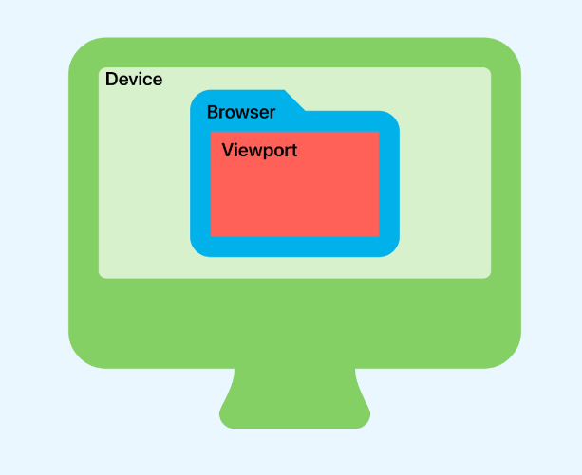
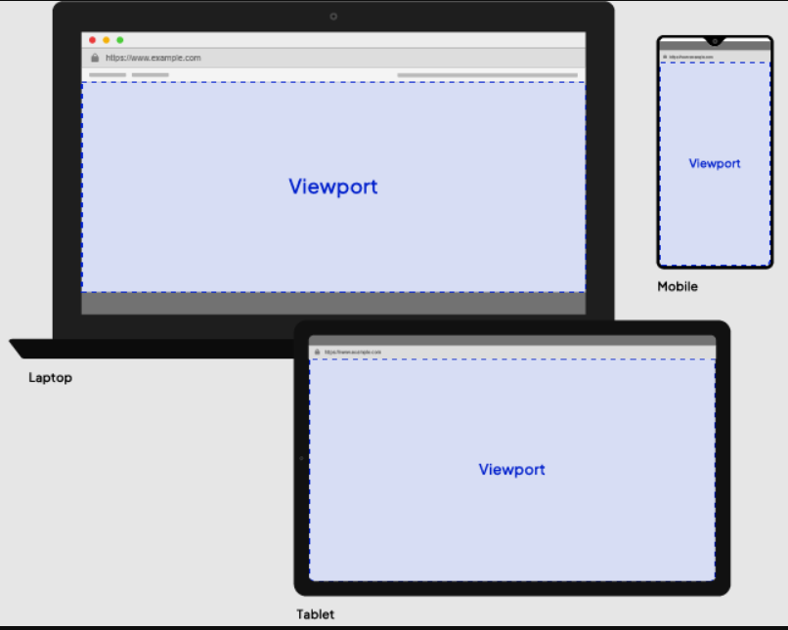
EXAMPLES

Slide 4
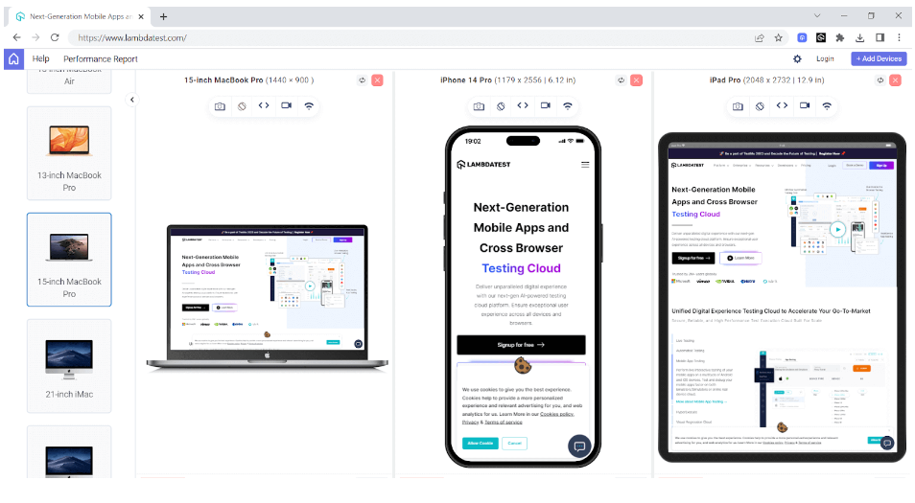
TOOLS
Manual tools
Take time
Hard to see bugs

Slide 5

CYPRESS
In Cypress, it is very easy to test on different viewports and verify how your website behaves across different screen sizes by specifying the desired dimensions.

Slide 6

CY.VIEWPORT()
You can simulate different viewports in Cypress using the cy.viewport() command.
By specifying the width and height parameters, you can test how your website responds to various screen sizes.

Slide 7
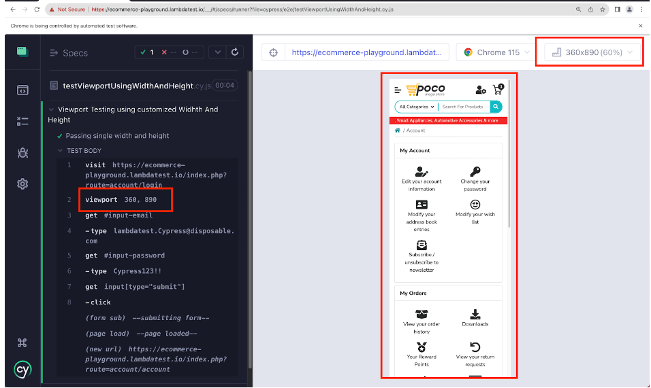
Test Device screens
Check multiples screen in one Test
Check orientation
Custom viewport

Slide 8

LET US CODE

